Slide 1
INTRO Recap – SW04
Thomas Kempf
Urs Stöckli

Slide 2
State Machines
Function State Machine
If-elseif-else State Machine
Switch State Machine
Mealy State Machine

Slide 3
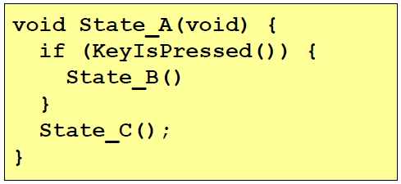
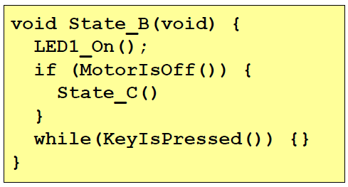
Function State Machine
Advantage
No global state variable needed
Disadvantage
Stack overflow possible
Recursion

Slide 4
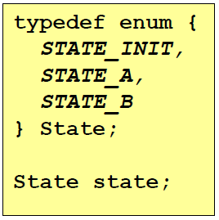
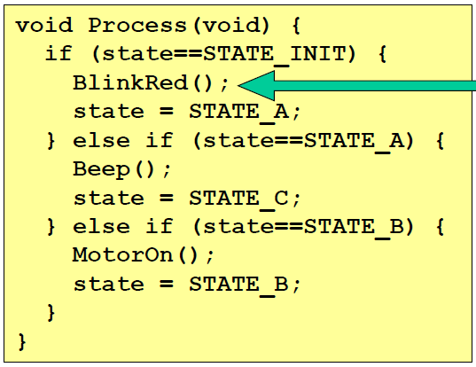

If-elseif-else State Machine
Disadvantage
Global state variable
Changing state outside processing
Volatile / reentrancy!

Slide 5
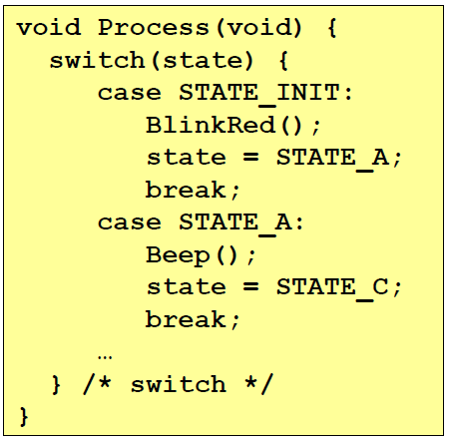
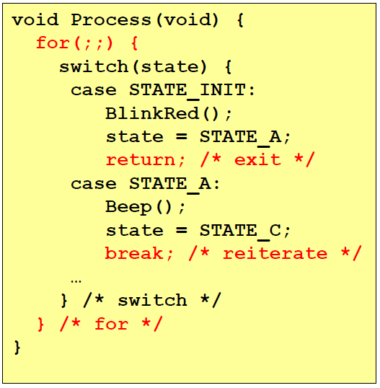
Switch State Machine
Advantage
Better structure
Disadvantage
Global state variable
Changing state outside processing
Volatile / reentrancy!
State change delayed with Processinterval
State change without Delay possible (break)

Slide 6
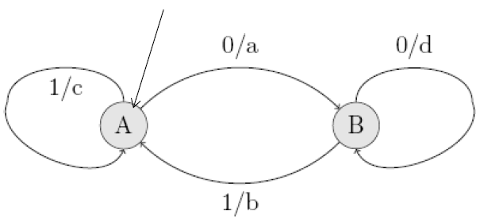
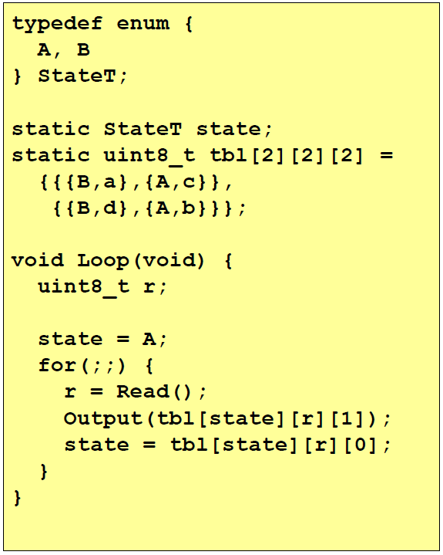
Mealy State Machine
State | 0 | 1
A | B/a | A/c
B | B/d | A/b

Slide 7
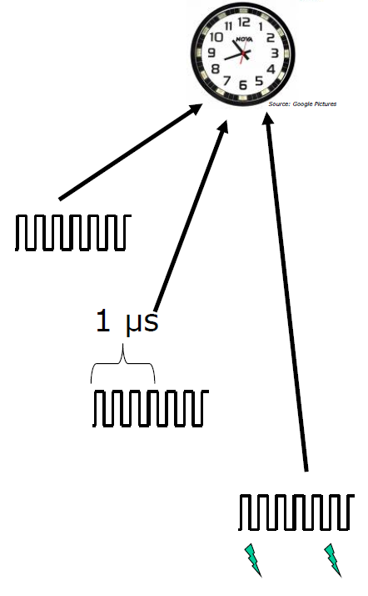
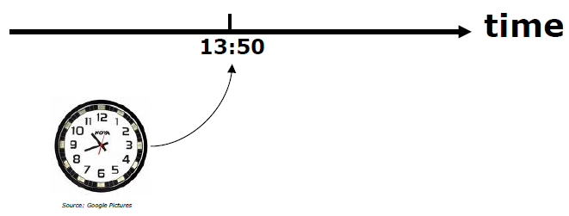
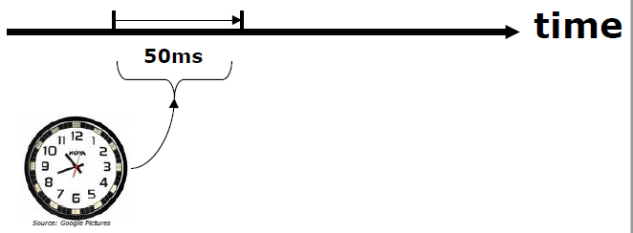
Clock & Timer
Clock
Absolute Time
Ticks per 1us
Relative Time
Set Event

Slide 8
Timer implementation
Clock count
generate timer interrupt TimerInt component (event all 10ms)
ProcessorExpert event
call TMR_OnInterrupt()
count ticks for required time Timer.c (abstraction)
set event
handle event Event.c
APP_EventHandler Application.c

Slide 9
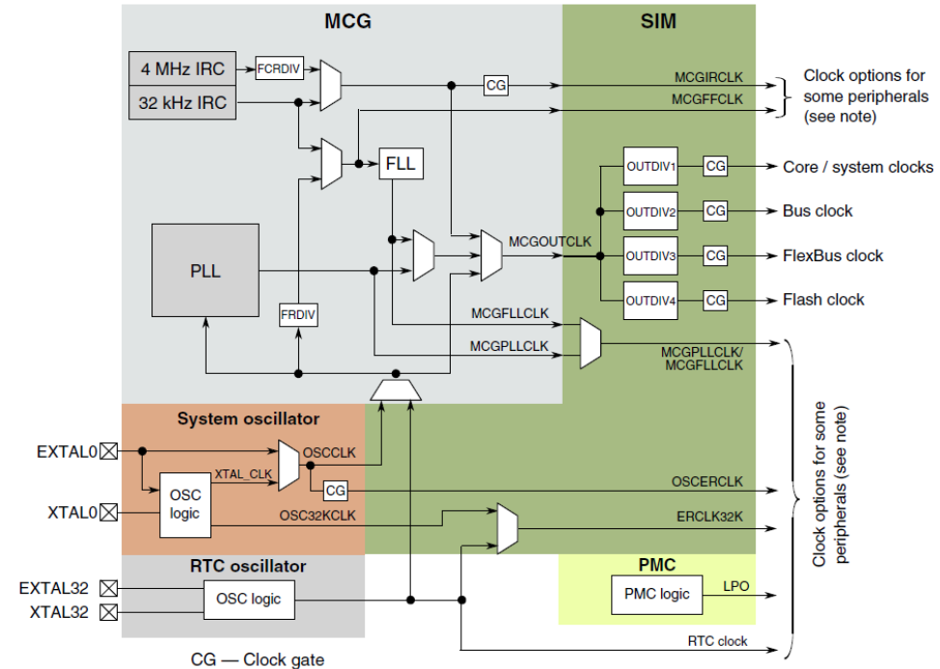
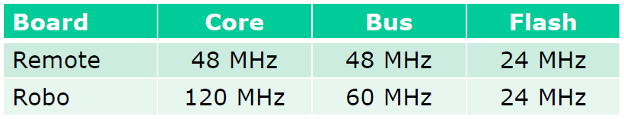
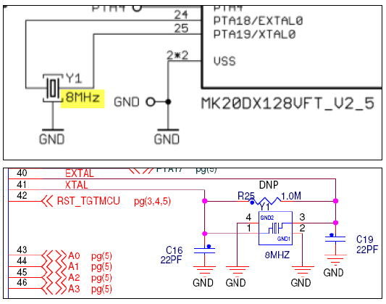
Clock

Slide 10
Questions
What is the job of the PLL in a microcontroller?
Frequency multiplication
What two different types of clock sources are available for the system clock?
Internal Clock
External Crystal/Oscillator
What is the advantage of the function state Machine?
No global variable needed
Which state machine is the simplest to implement from a Table?
Mealy Sequential Machine
How we can realize many different timer in our project with just one time base?
With counter

Slide 11
Questions
What is the job of the PLL in a microcontroller?
Frequency multiplication
What two different types of clock sources are available for the system clock?
Internal Clock
External Crystal/Oscillator
What is the advantage of the function state Machine?
No global variable needed
Which state machine is the simplest to implement from a Table?
Mealy Sequential Machine
How we can realize many different timer in our project with just one time base?
With counter

Slide 12
Questions
What is the job of the PLL in a microcontroller?
Frequency multiplication
What two different types of clock sources are available for the system clock?
Internal Clock
External Crystal/Oscillator
What is the advantage of the function state Machine?
No global variable needed
Which state machine is the simplest to implement from a Table?
Mealy Sequential Machine
How we can realize many different timer in our project with just one time base?
With counter

Slide 13
Questions
What is the job of the PLL in a microcontroller?
Frequency multiplication
What two different types of clock sources are available for the system clock?
Internal Clock
External Crystal/Oscillator
What is the advantage of the function state Machine?
No global variable needed
Which state machine is the simplest to implement from a Table?
Mealy Sequential Machine
How we can realize many different timer in our project with just one time base?
With counter

Slide 14
Questions
What is the job of the PLL in a microcontroller?
Frequency multiplication
What two different types of clock sources are available for the system clock?
Internal Clock
External Crystal/Oscillator
What is the advantage of the function state Machine?
No global variable needed
Which state machine is the simplest to implement from a Table?
Mealy Sequential Machine
How we can realize many different timer in our project with just one time base?
With counter

Slide 15
Questions
What is the job of the PLL in a microcontroller?
Frequency multiplication
What two different types of clock sources are available for the system clock?
Internal Clock
External Crystal/Oscillator
What is the advantage of the function state Machine?
No global variable needed
Which state machine is the simplest to implement from a Table?
Mealy Sequential Machine
How we can realize many different timer in our project with just one time base?
With counter variable

